Slide 1
Virus Validate
Software Engineering
Team 5
James Bui
Sonya Shin
Michelle Her
Justin Djojomartono

Slide 2
Purpose of the Software System
The purpose of this software system is to validate guests/visitors who do not have COVID or COVID related symptoms. With this validation made, said guests/visitors that are scheduled to attend an office meeting may attend one.
The system will include a validator and a scheduler.
Guests/visitors will be verified to make sure that they have an applicable meeting to attend to by inputting their information
The validator will be implemented through the use of a COVID questionnaire, where the results will either deny or grant permission into the office meeting.
Scheduler shows each recipient the time/day slot for their office meeting.

Slide 3
Technical Platforms
Firebase - Database
Database to hold the data of guests/visitors and their corresponding meeting information (date and time of meeting) and the validation or invalidation assigned to each guests/visitors based upon answers to the questionnaire.
Javascript, PHP - Language
Website will act as the main interaction between guests/visitors and the software. Here, guests will be verified and will be able to see the list of schedules of meetings. Additionally, the COVID questionnaire will be answered through the website.
Web Scraping - Javascript, Node.js
Performs the main function of grabbing the COVID symptom/identification questions from the CDC website in order to be used for the website-implemented questionnaire.
WordPress - Web Hosting

Slide 4
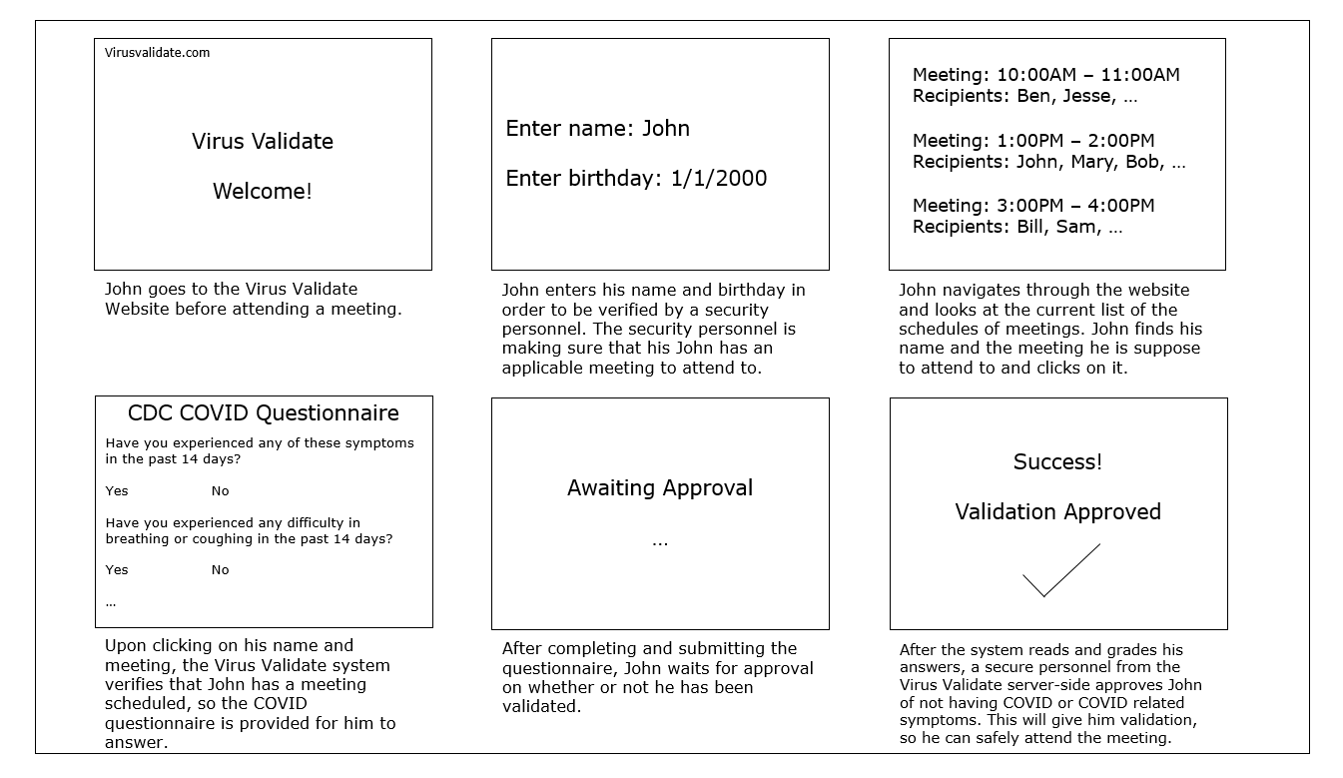

Slide 5
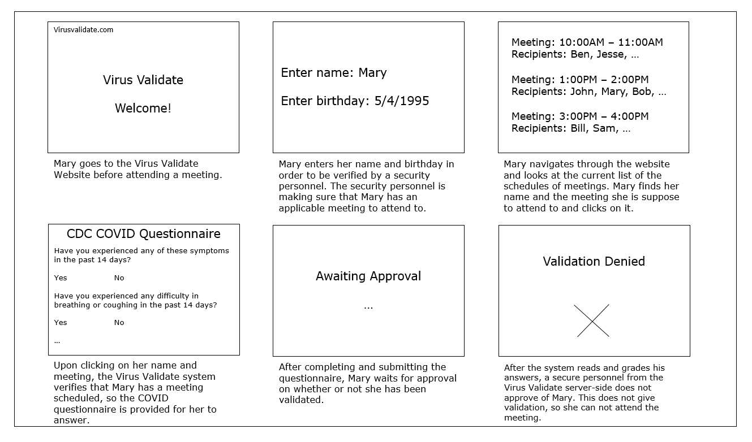

Slide 6
